Slide 1
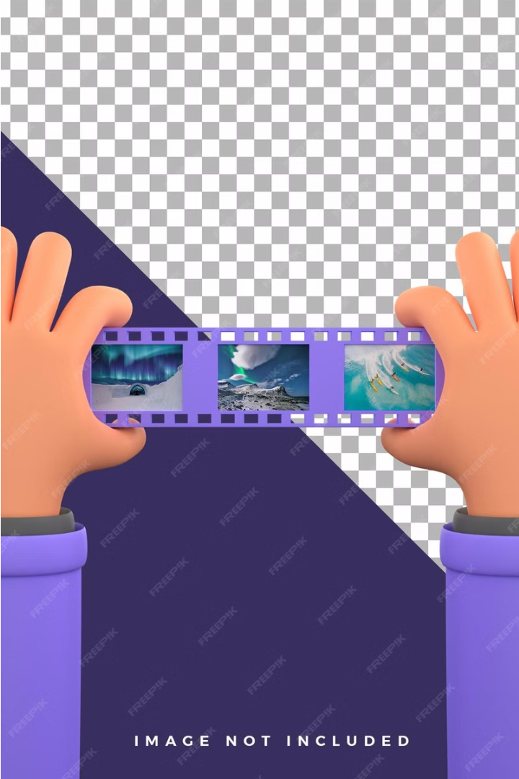
Gesture-Based Video Editor: Revolutionizing Video Editing
Explore the cutting-edge technology revolutionizing the video editing landscape by leveraging intuitive gesture-based controls. Designed for filmmakers, vloggers, and content creators.

Slide 2

Project Overview
Intuitive Gesture Control: Streamline video editing with natural hand motions.
Real-Time Video Manipulation: Instantly cut, splice, and transform footage in the moment.
Adaptive AI Integration: Intelligent technology that learns your editing style and preferences.
Multi-Platform Compatibility: Seamless video editing on desktop, mobile, and VR devices.

Slide 3

Technology Stack
Computer Vision
Real-Time Video Processing
Cross-Platform Compatibility
Leverages AI and ML to interpret hand gestures
Enables instant video editing using motion controls
Designed for seamless use on desktop, mobile, and VR

Slide 4
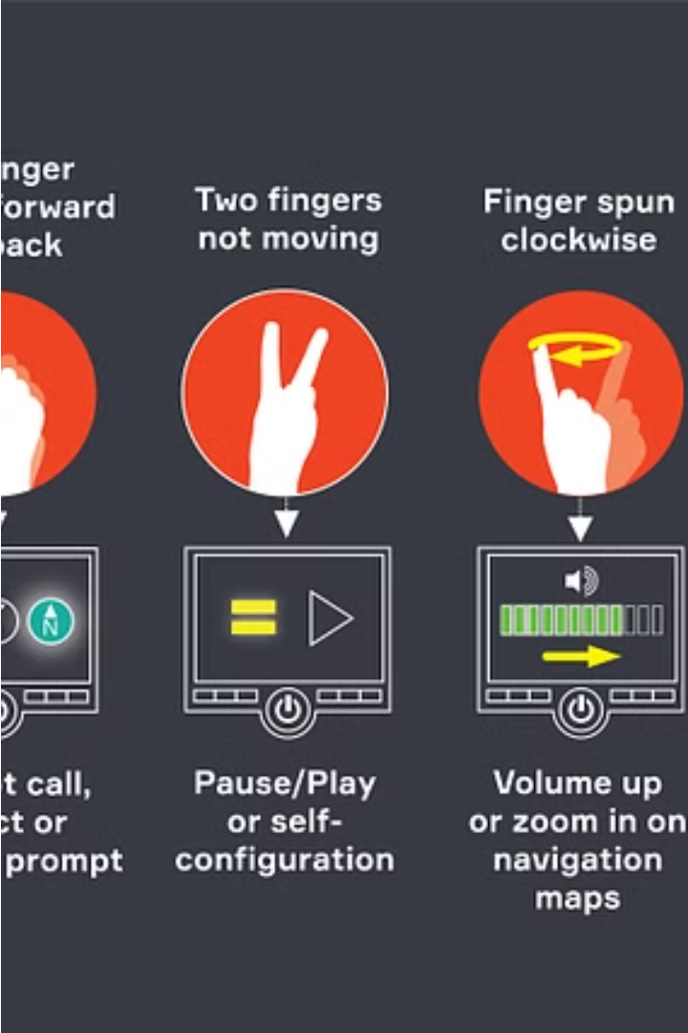
Gesture Recognition System
Our cutting-edge gesture recognition technology uses advanced machine learning and computer vision to seamlessly interpret intricate hand movements and thumb gestures, enabling precise control over your video editing workflows.

Slide 5




Main Gestures and Functions
Start
Stop
Cut
Paste
Initiate video playback with a simple hand gesture.
Freeze the video timeline with a palm-down motion.
Precisely trim footage by slicing the air with your fingers.
Seamlessly insert new clips by swiping your hand across the screen.

Slide 6
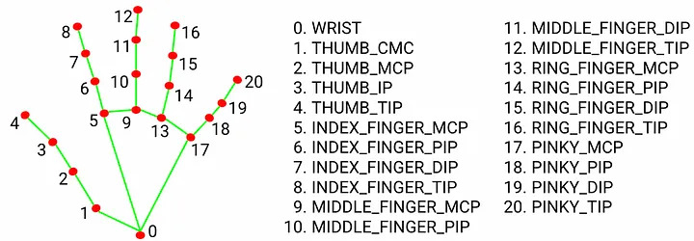
Hand landmark model:

Slide 7
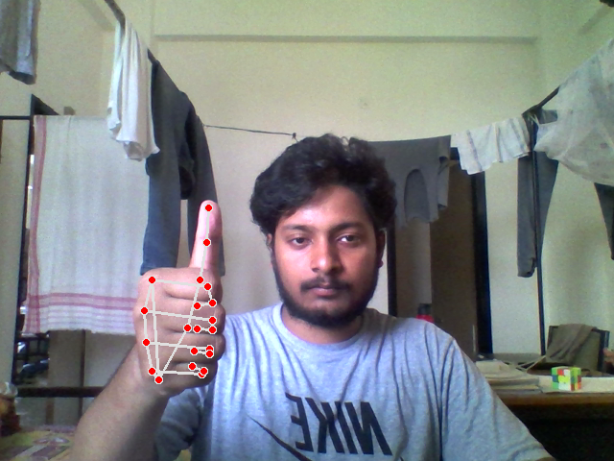
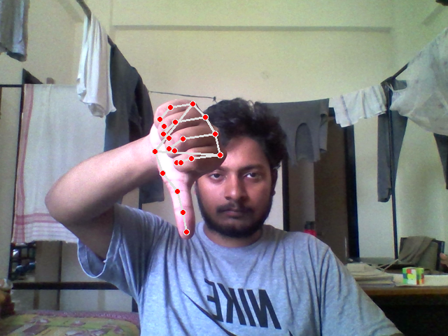
Demo
Start Recording
Stop Recording

Slide 8
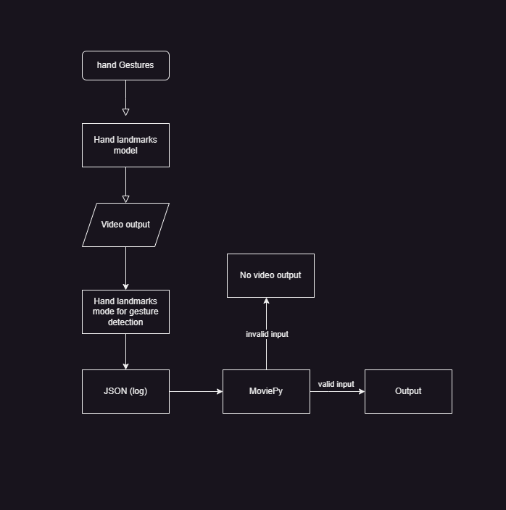

Slide 9

Challenges and Solutions
Overcoming development hurdles in gesture recognition and real-time video processing.
Implementing robust machine learning models to accurately interpret complex hand motions.

Slide 10



Future Enhancements
Advanced Gesture Library
1
Expand motion controls for precise editing
Augmented Reality Integration
2
Seamless video manipulation in 3D space
Adaptive AI-Powered Editing
3
Intelligent assistant that learns your style
As we continue to push the boundaries of gesture-based video editing, we envision a future where our technology integrates even deeper into the creative workflow. This includes expanding our library of intuitive hand motions, enabling immersive augmented reality editing experiences, and developing adaptive AI systems that learn and anticipate your editing preferences.

Slide 11

Conclusion
Revolutionizes Video Editing
Boosts Creativity and Productivity
Intuitive gesture-based controls transform the editing workflow
Frees users to focus on creative expression, not technical complexities
Industry-Changing Impact
Sets a new standard for the future of video production

